Slide 1

SMART SOLUTIONS SEMESTER
Testing device membrane fabrics for motorcycling

Slide 2

CONTENT
Introduction
Creation of the prototype
Testing
Results
Manual
Questions

Slide 3

INTRODUCTION
01.

Slide 4

REV’IT!
Saxion University of Applied Science Enschede
Electrical Engineering and Fashion & Textile Technologies
Comfort and safety
Create a testing device which can determine the breathability of a fabric by measuring the weight of the cup, the temperature and the humidity

Slide 5
CREATION
OF THE PROTOTYPE
02.

Slide 6
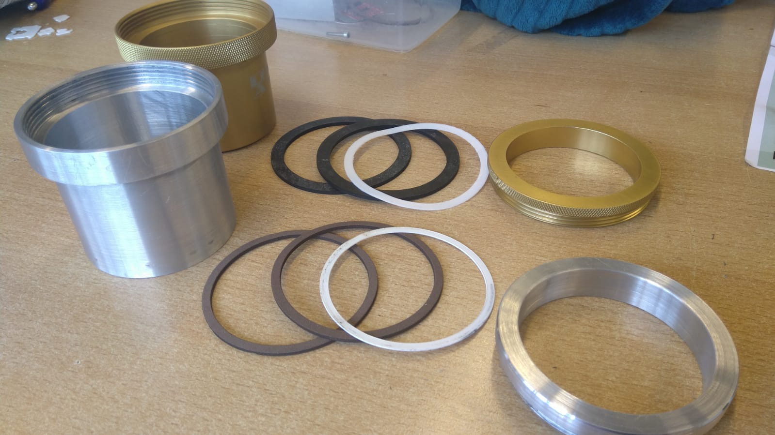
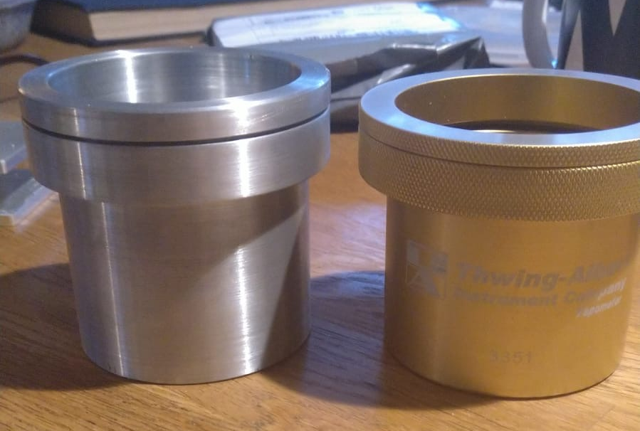
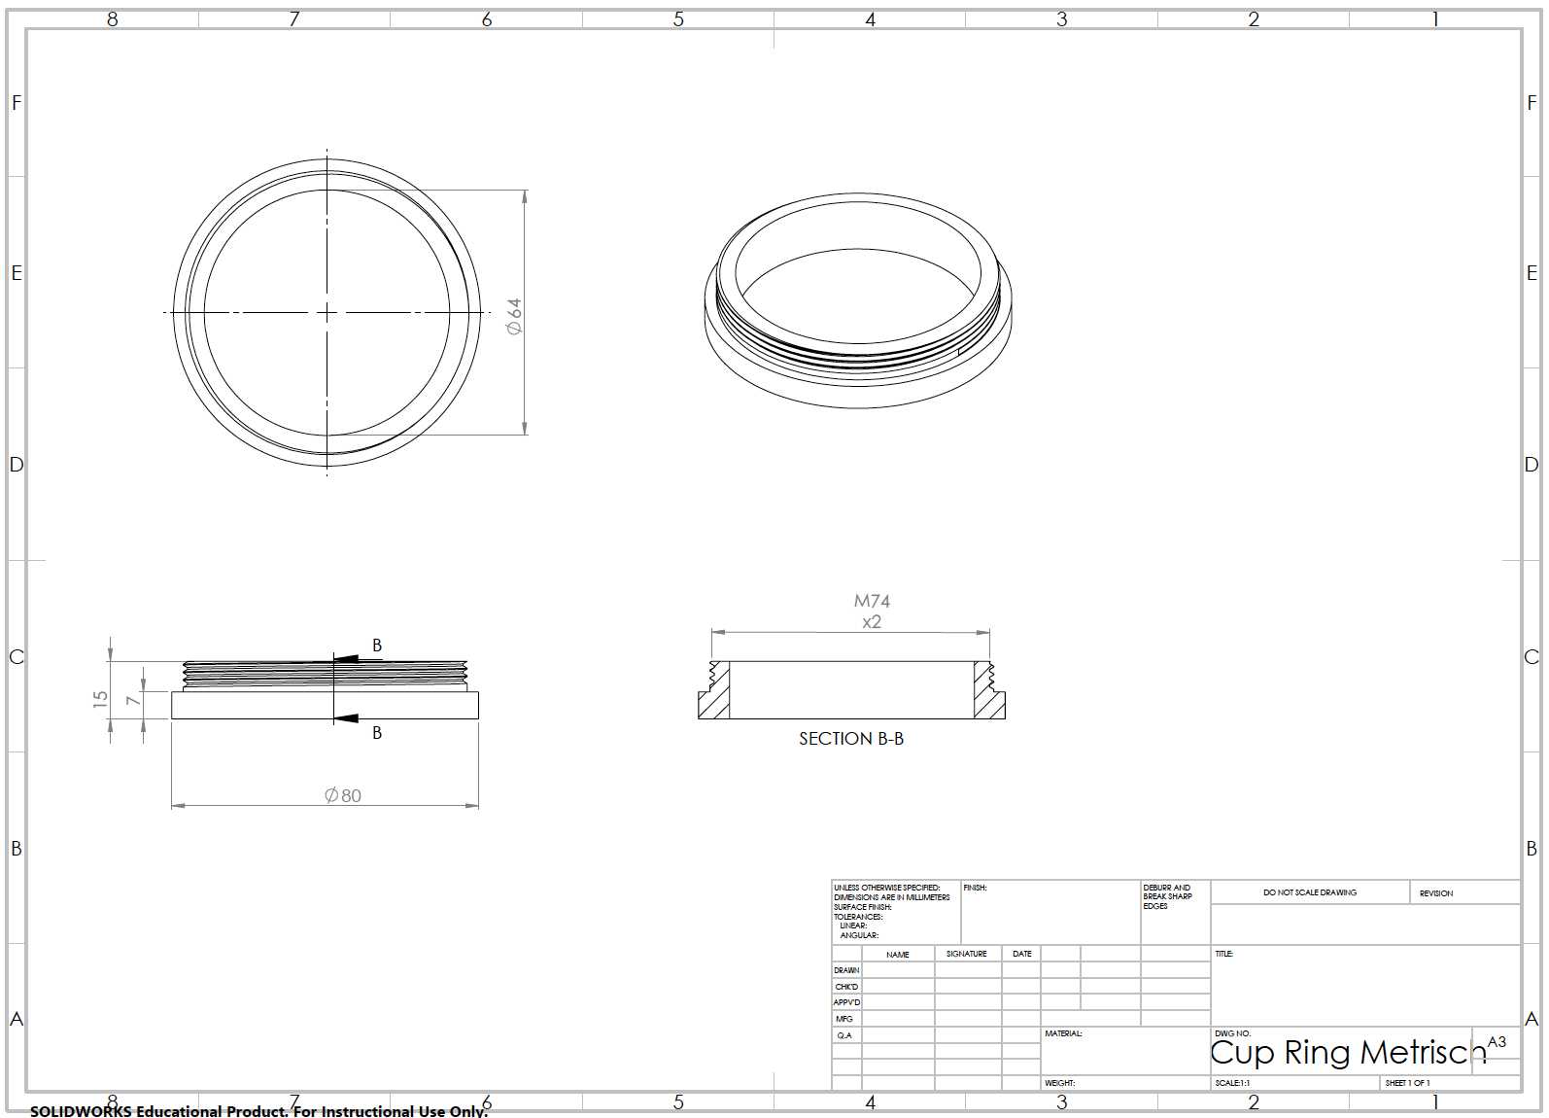
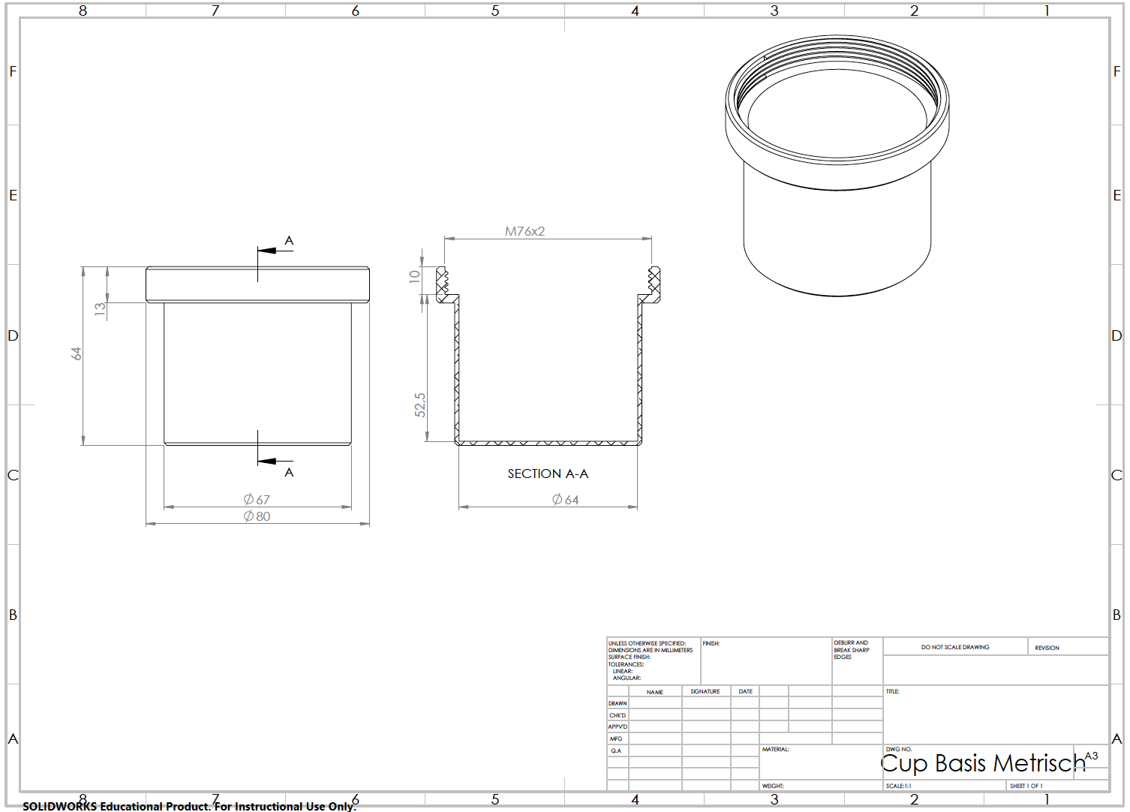
RECREATION
Recreated rings
Laser cut foam and paper rings
Recreated cup
Aluminium cup
Technical drawing cup ring
Recreated aluminium cup ring
Technical drawing cup
Recreated aluminium cup

Slide 7
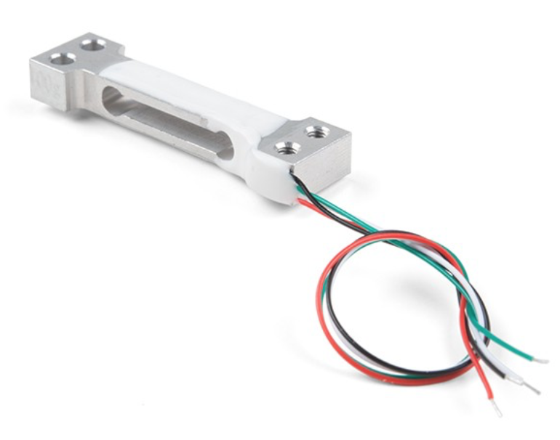
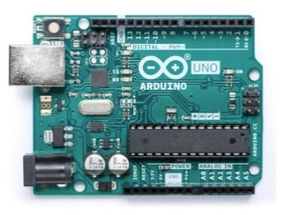
SENSORS

Slide 9
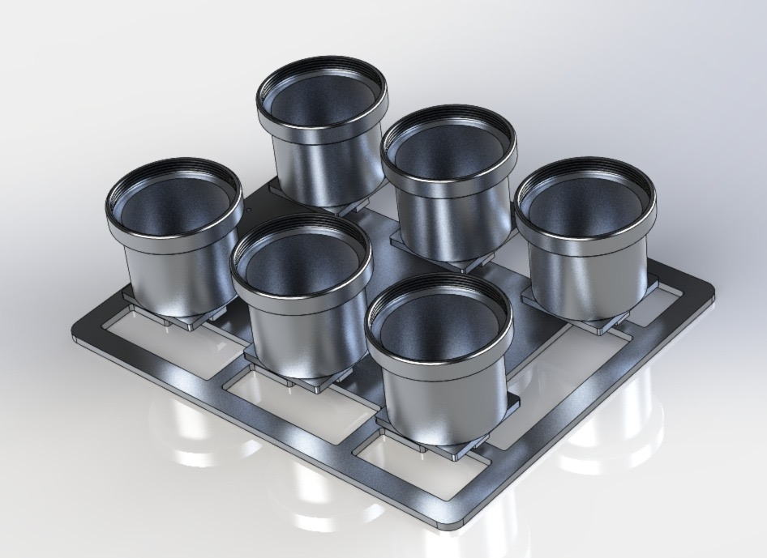
EXPECTED VIEW PROTOTYPE
3D
VIEW

Slide 10
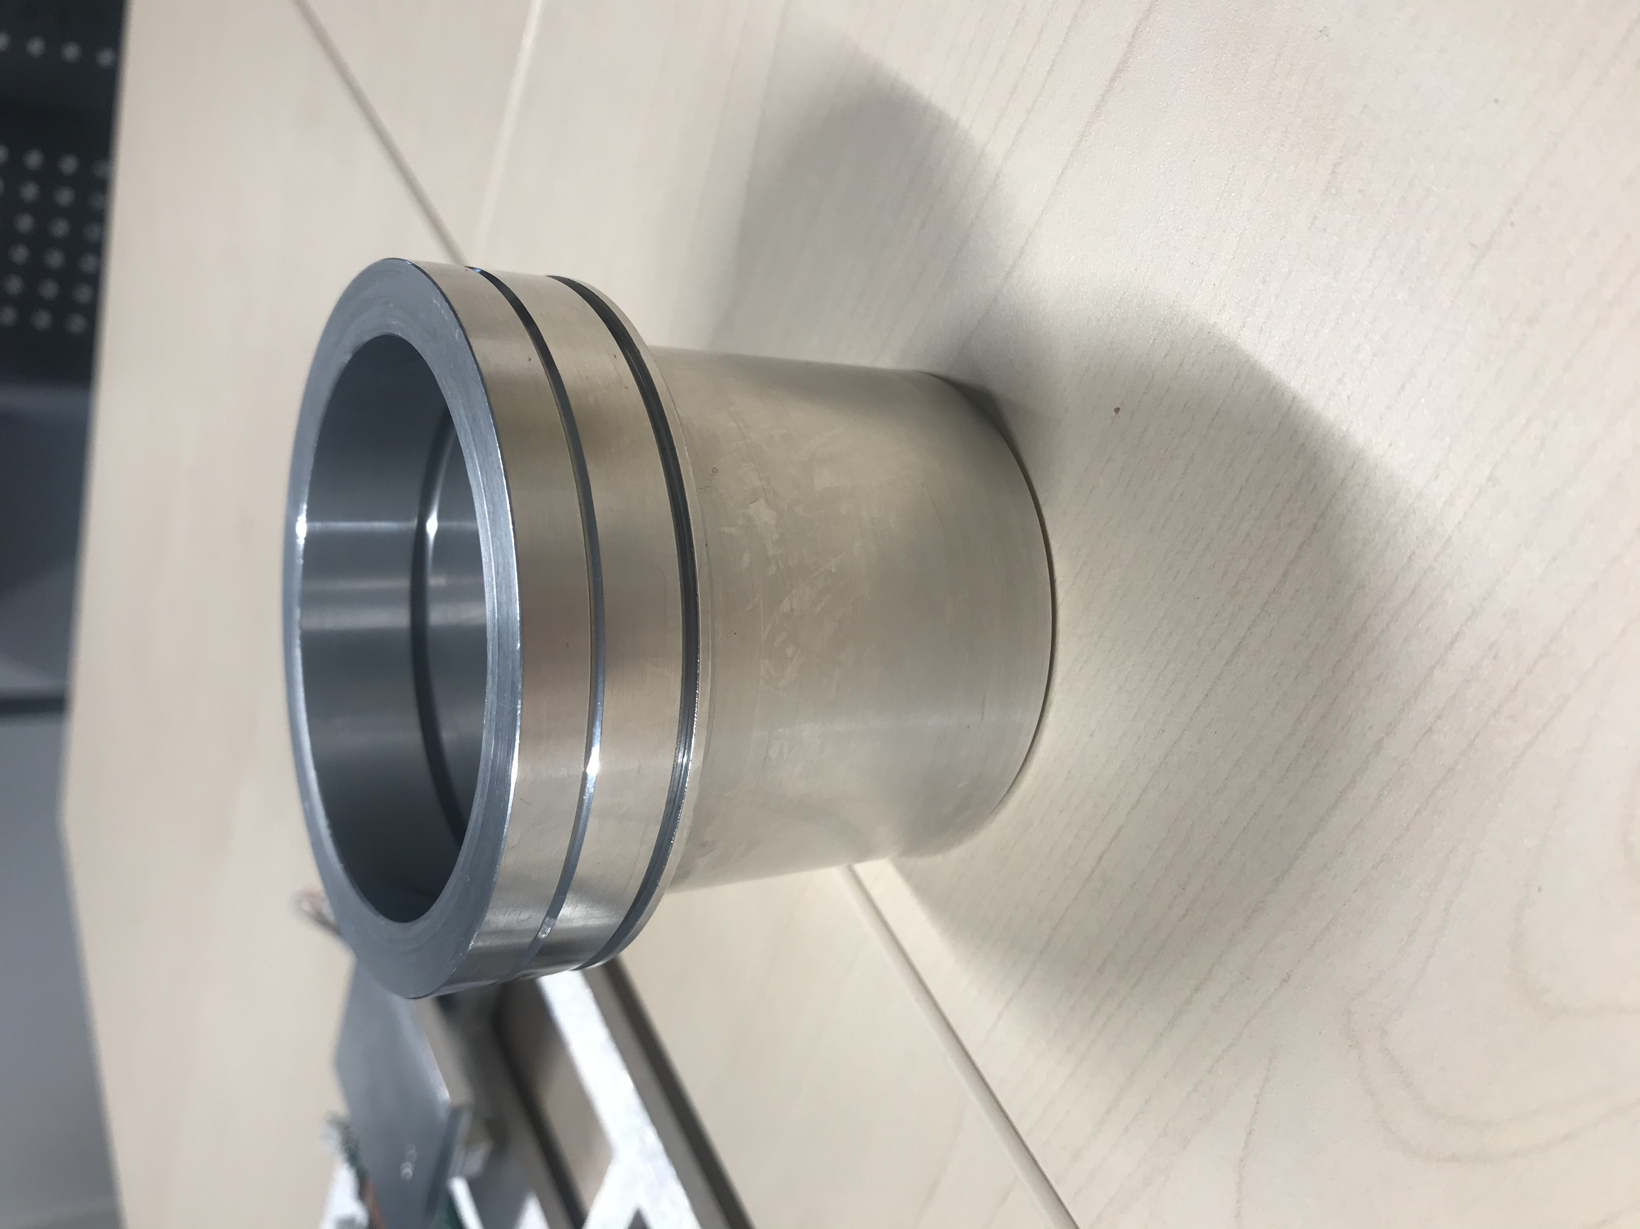
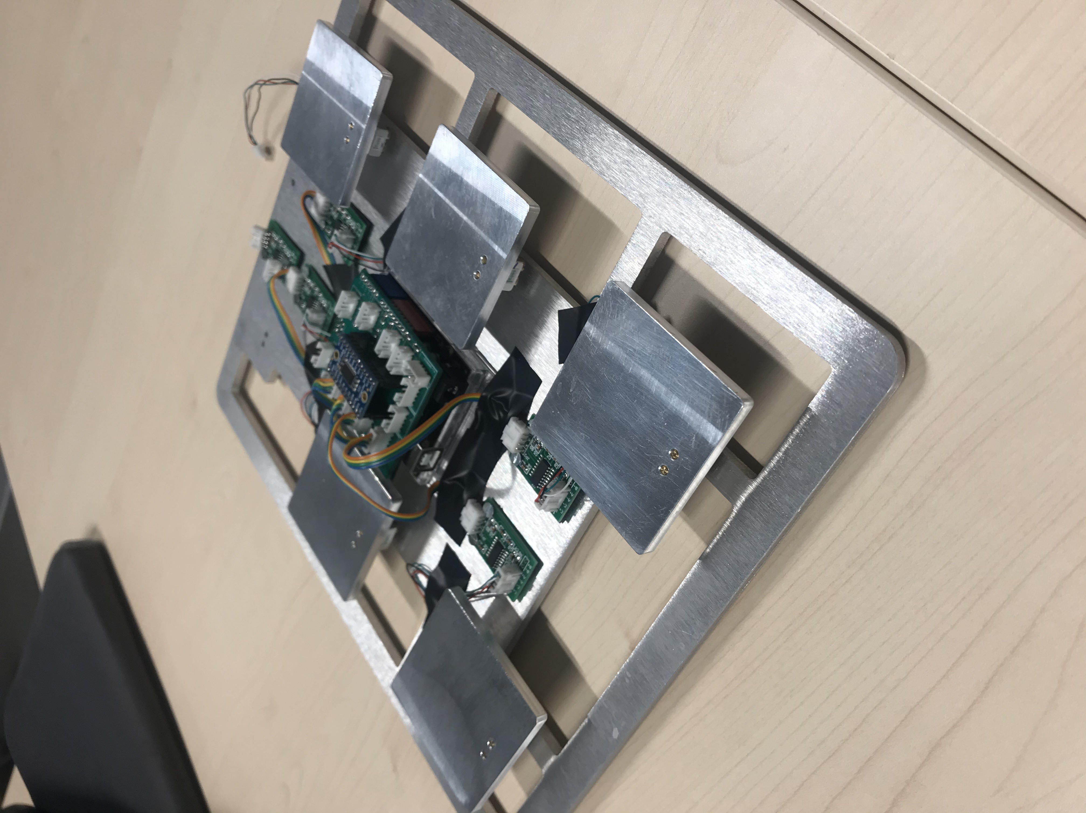
PROTOTYPE

Slide 11
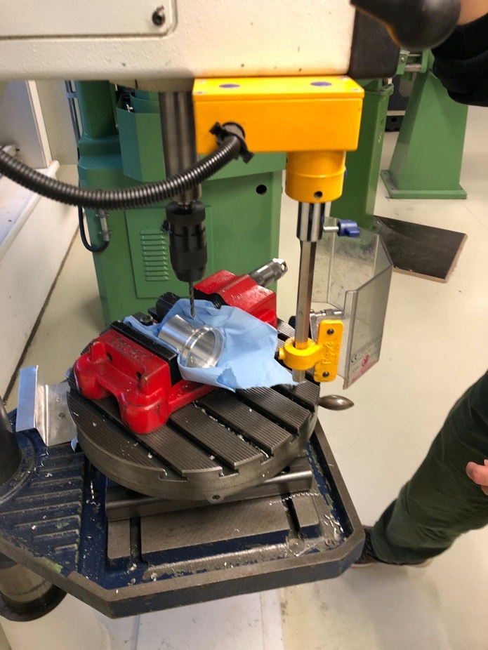
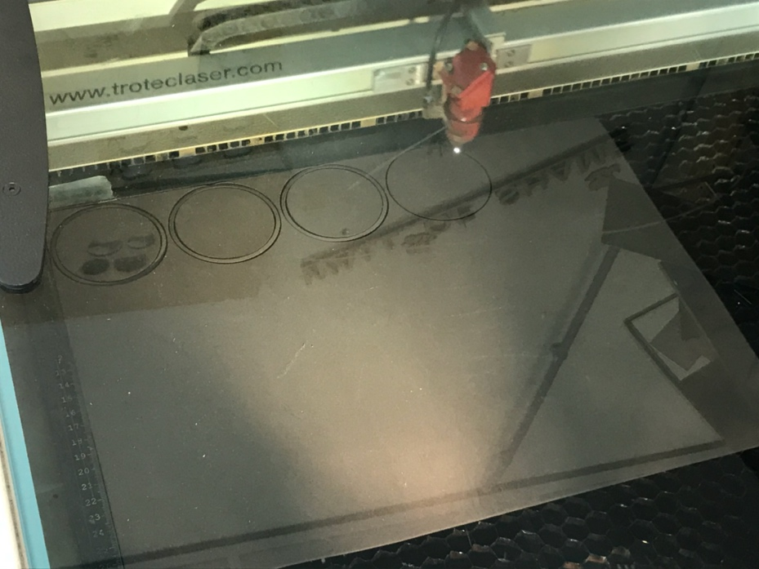
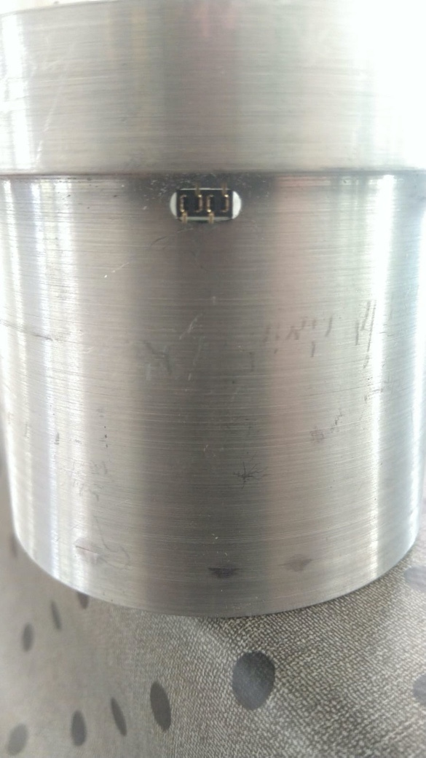
MANUFACTURE

Slide 12
HERAEUS B 5028
230 V
50-60 Hz
0.29 kW
30 liters
10o C - 70o C
Built-in thermometer
Smooth regulation
29 kgs
Inside: 28 x 33 x 35 cm

Slide 13
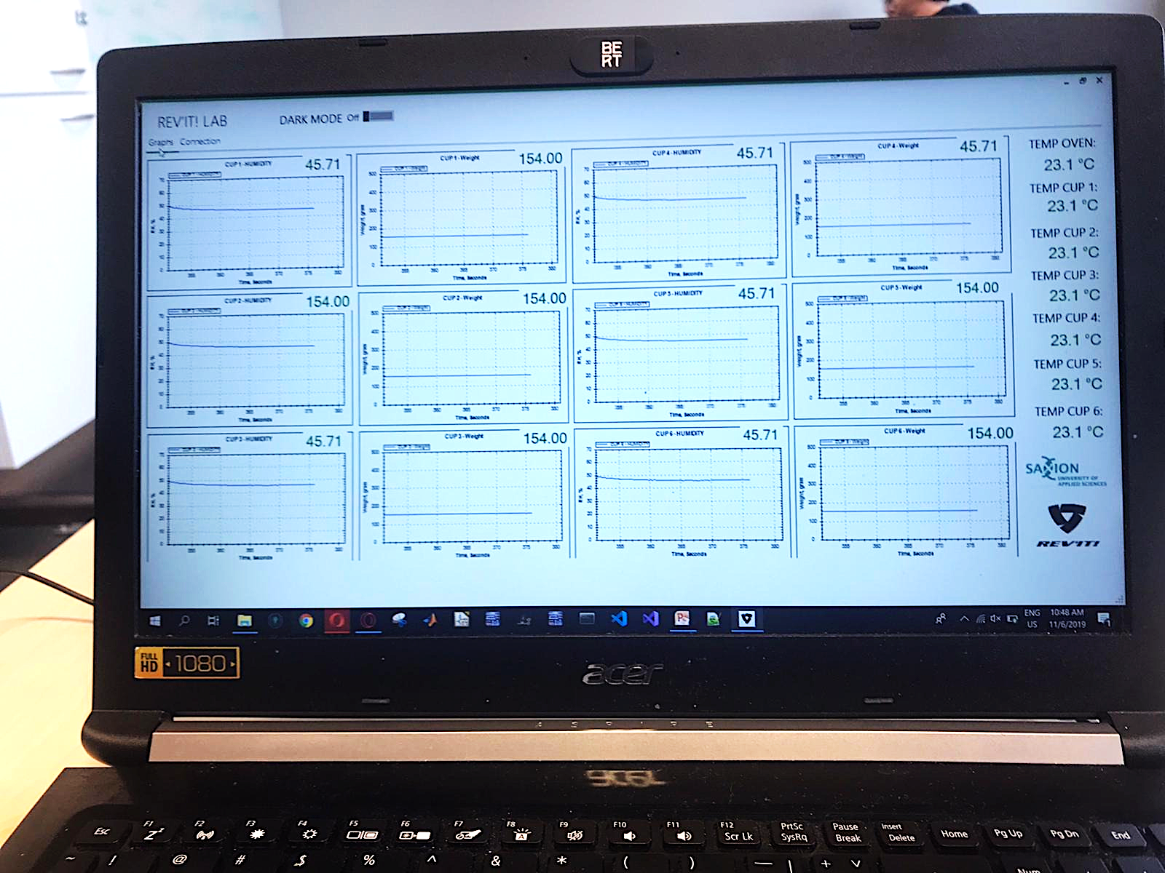
SOFTWARE

Slide 14
TESTING
03.

Slide 15
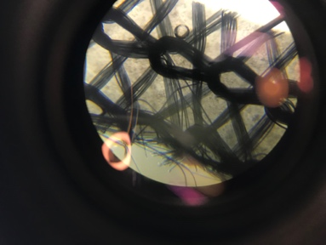
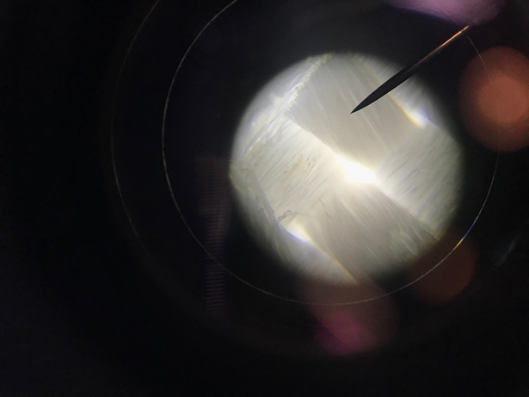
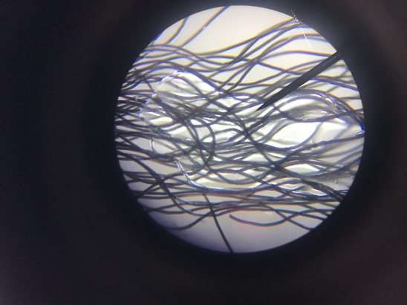
CHEMICAL LAB

Slide 16
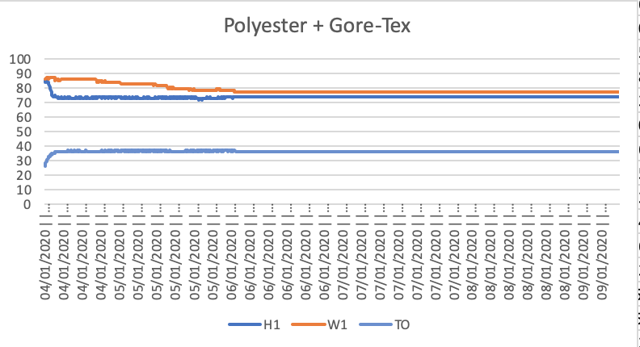
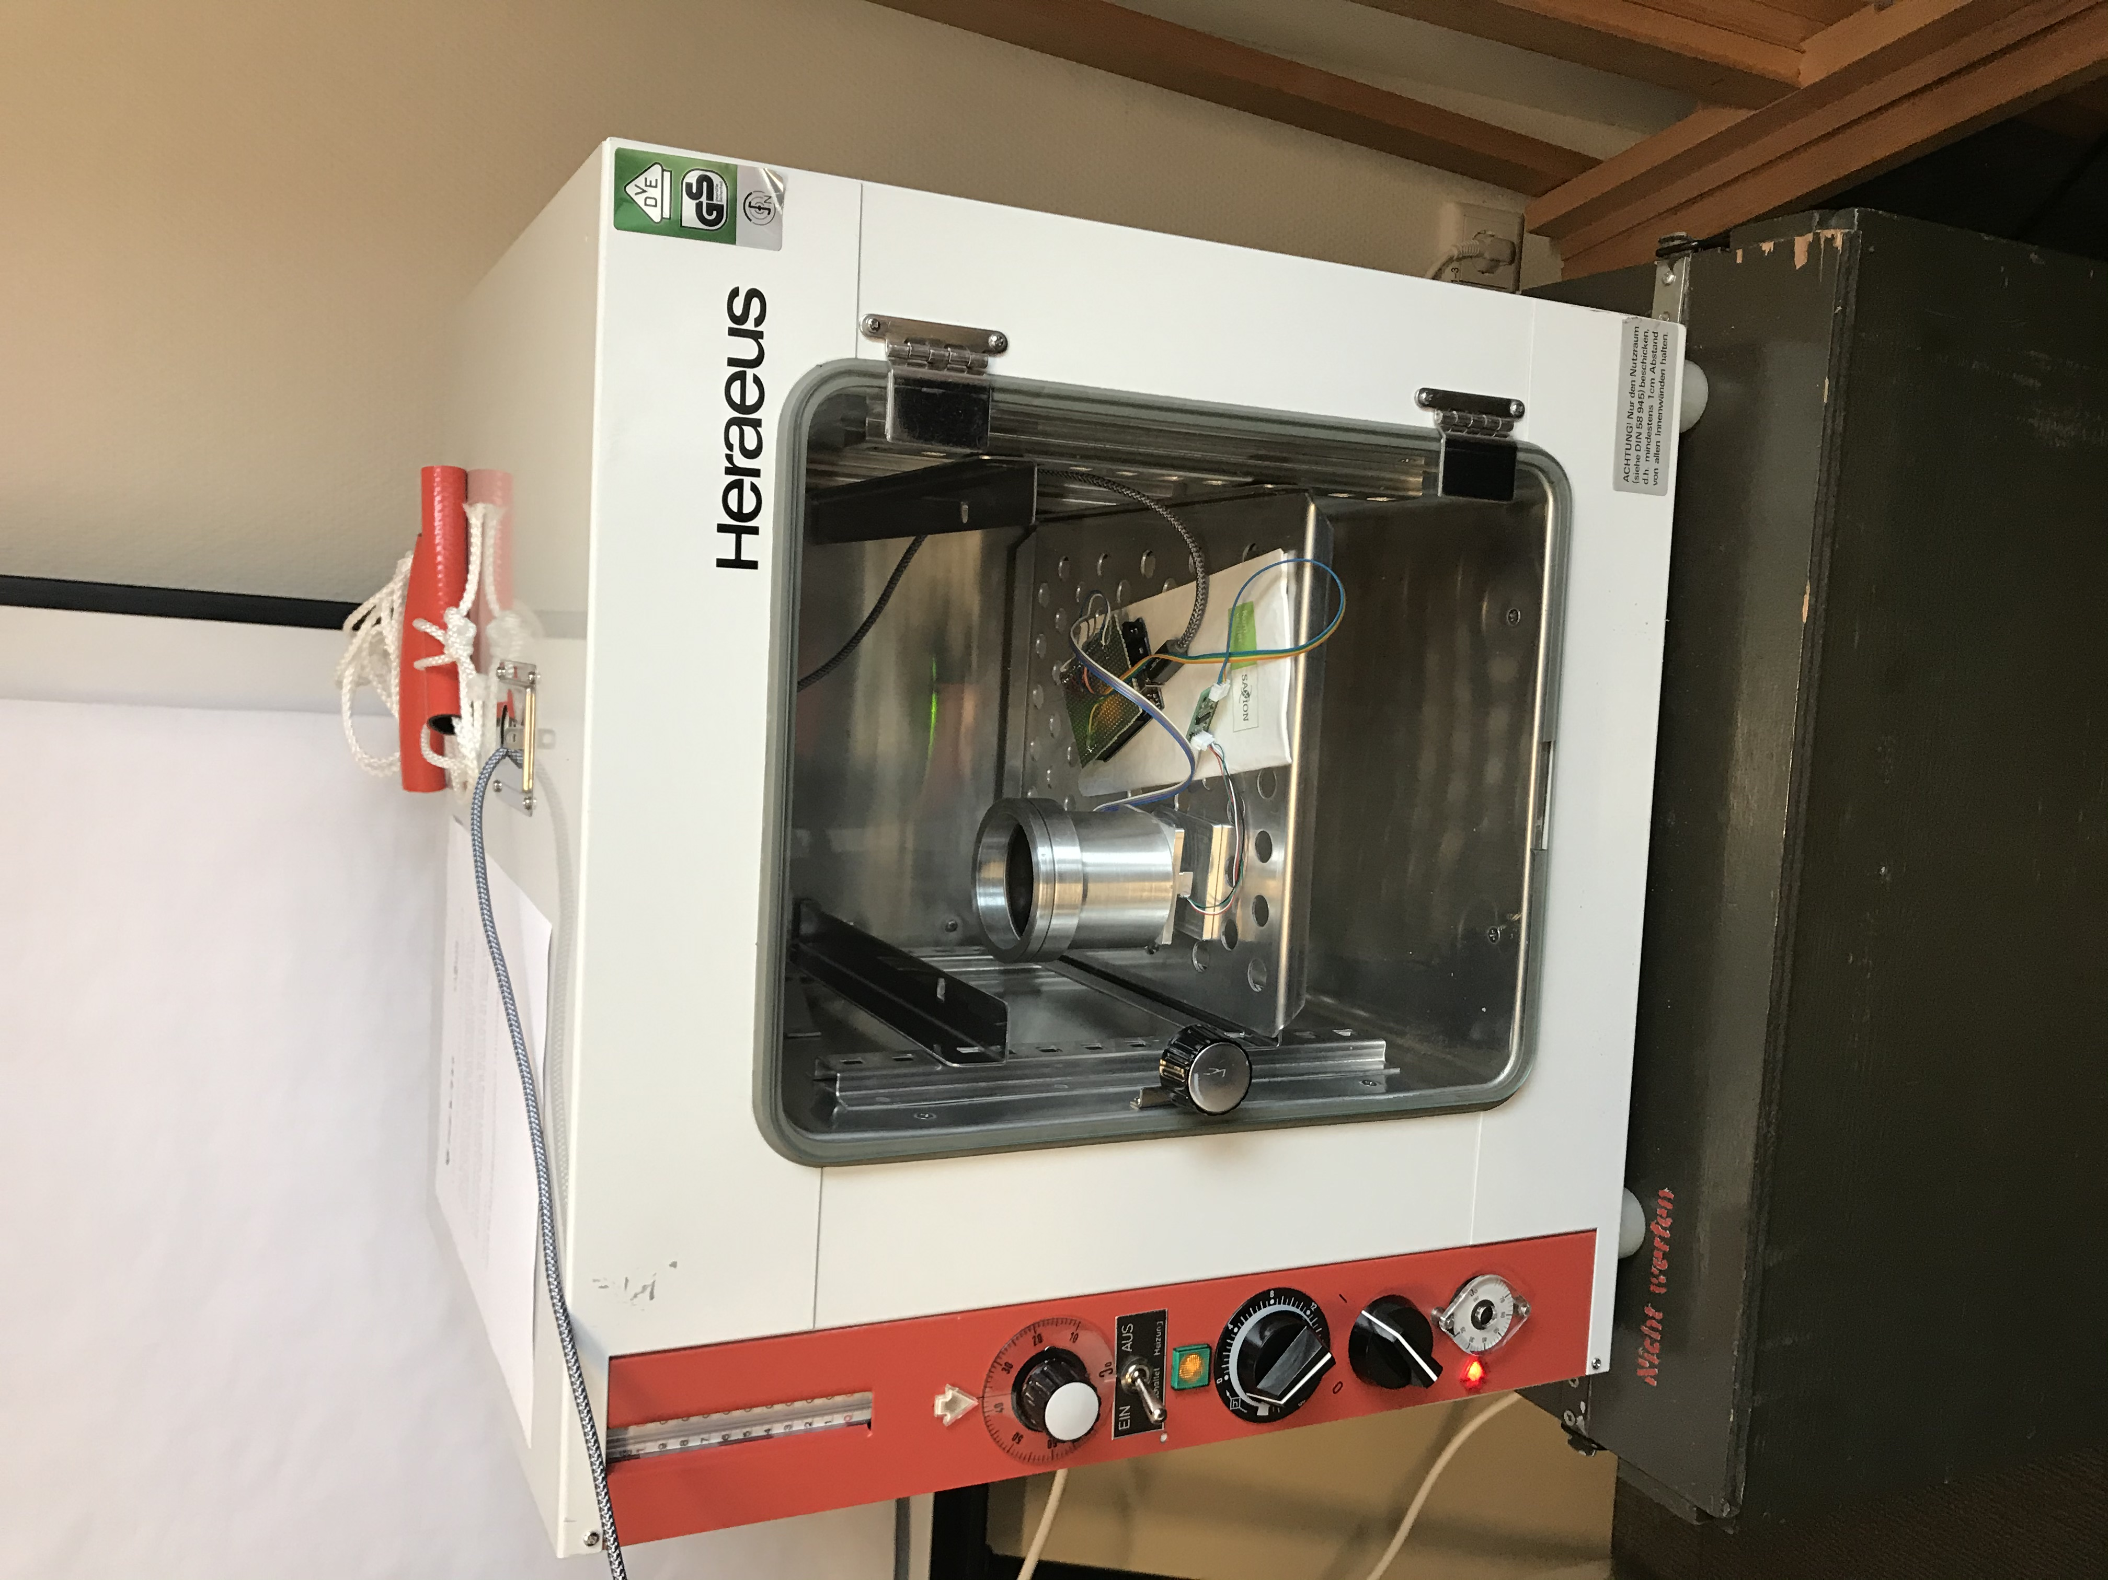
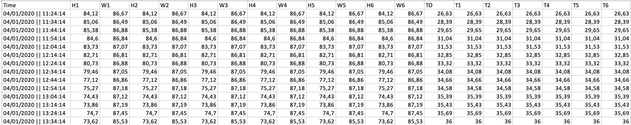
TESTING PROTOTYPE

Slide 17
RESULTS
04.

Slide 18
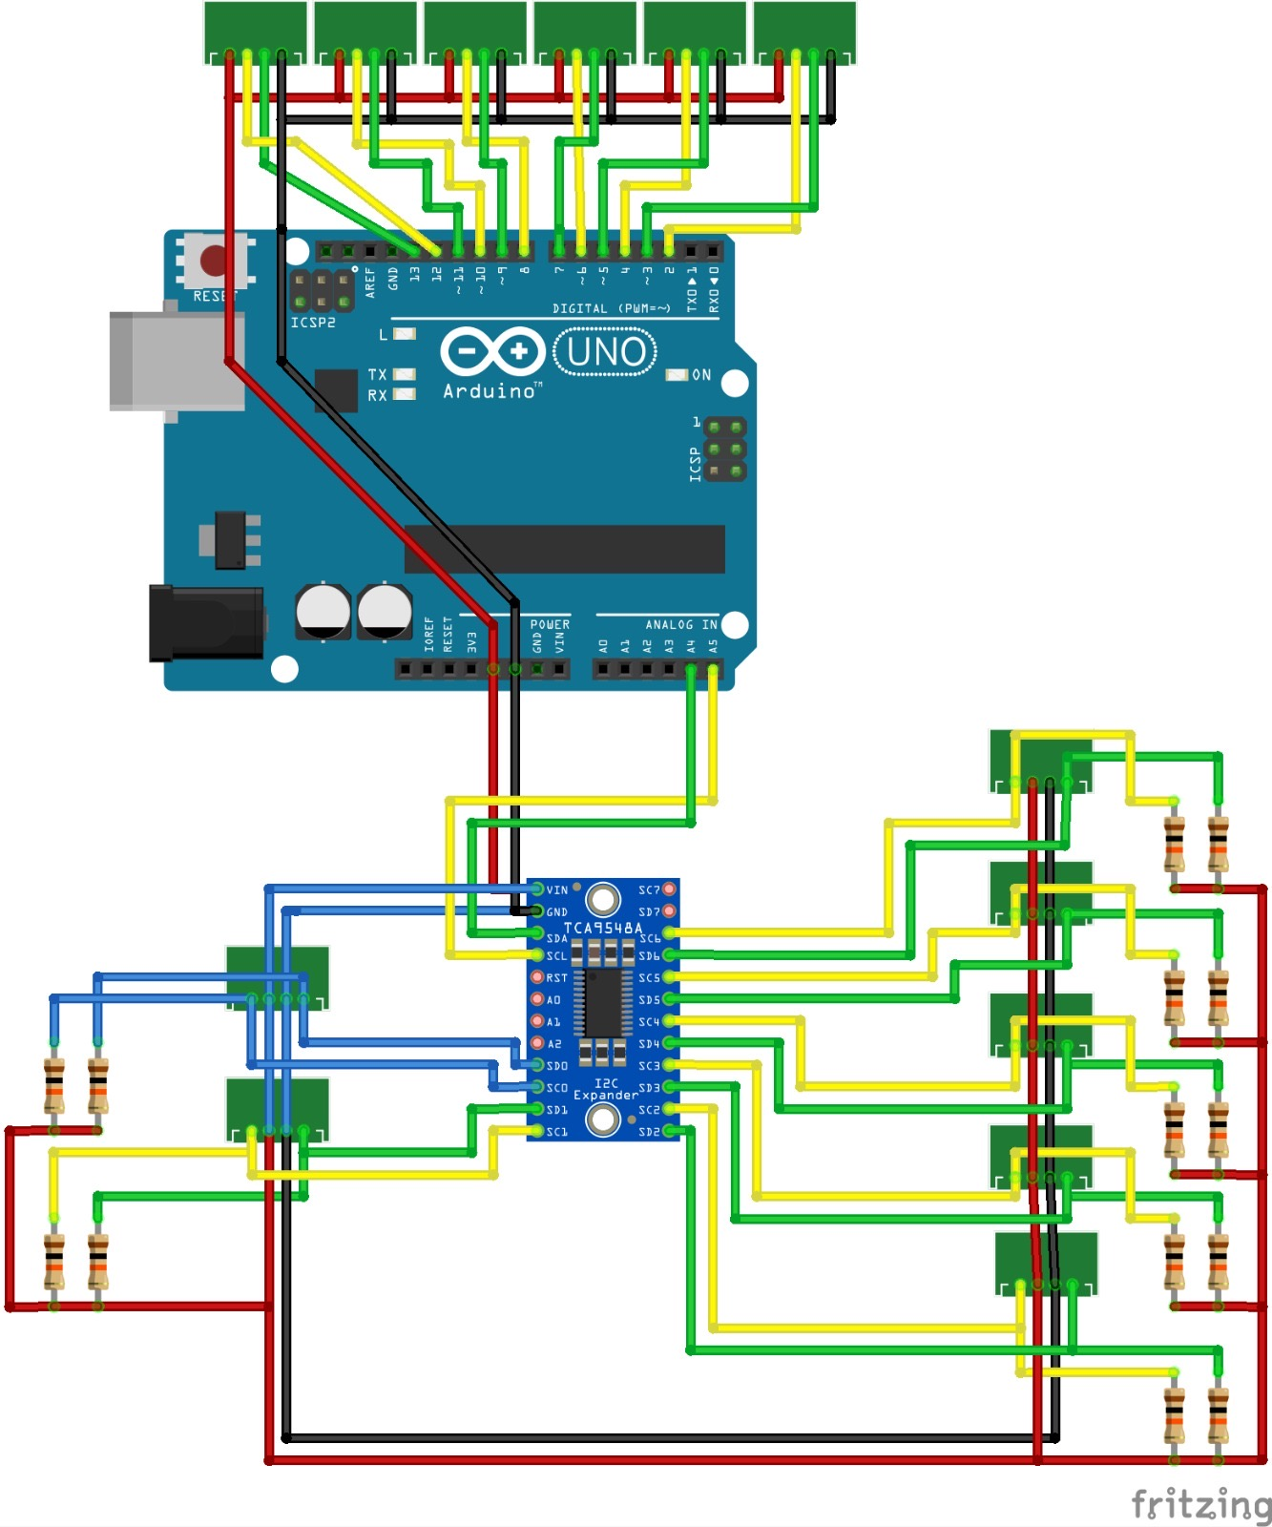
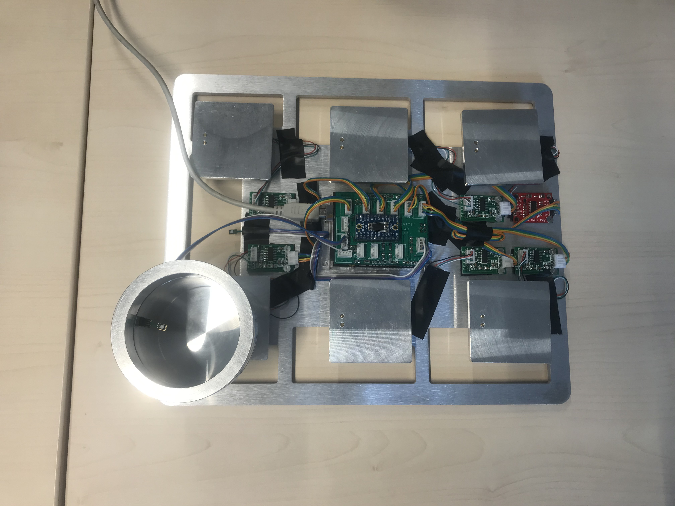
FINAL PROTOTYPE

Slide 19
MANUAL
05.

Slide 21
QUESTIONS?

